Slide 1
PRESENTED BY : DHARSHANA C REG NO : 813821205009 DEPT : INFORMATION TECHNOLOGY COLLEGE : SARANATHAN COLLEGE OF ENGINEERING NM ID : dharshanacdharshanac@gmail.com (au813821205009)
Enhancing Rainfall Prediction Accuracy Through Machine Learning
3/21/2024 Annual Review

Slide 2
PROJECT TITLE
Rain Predictor Using Machine Learning
Project Title: "Rain Predictor Using ML"
Objective: Enhancing Rainfall Forecasting
Key Components: Data Collection, ML Model Training
Expected Outcome: Improved Rainfall Prediction Accuracy
Audience: Agriculture, Water Management, Disaster Response
Methodology: Historical Weather Data, ML Algorithms
Conclusion: Advancing Weather Forecasting Techniques
3/21/2024 Annual Review

Slide 3

AGENDA
Project Introduction
Project Title and Objective
Problem Statement and Significance
Methodology Overview
Data Collection and Preprocessing
Machine Learning Model Selection
Model Training and Evaluation
Key Results and Findings
Accuracy of Rainfall Predictions
Comparison with Traditional Methods
User Interface Development
Real-time Access to Rainfall Forecasts
User Feedback and Improvement Iterations
Future Scope and Potential Applications
Integration of Real-time Data Streams
Collaborative Opportunities
Conclusion and Q&A
Project Impact and Contributions
Questions and Discussion
3/21/2024 Annual Review

Slide 4

PROBLEM STATEMENT
"Developing a machine learning-based rain predictor to improve the accuracy and timeliness of rainfall forecasts for enhanced resource management and decision-making in various sectors."
Current Challenges
Traditional methods of rainfall prediction lack accuracy and timely updates.
Inaccurate forecasts can lead to mismanagement of resources in sectors like agriculture and water management.
Significance of the Problem
Accurate rainfall prediction is crucial for decision-making in agriculture, disaster response, and water resource management.
Timely and reliable forecasts can prevent losses and improve resource allocation.
Objective
Develop a machine learning-based rain predictor to address the limitations of traditional forecasting methods.
Enhance the accuracy and timeliness of rainfall predictions for better resource management and decision-making.
3/21/2024 Annual Review

Slide 5

PROJECT OVERVIEW
Objective: Enhancing Rainfall Forecasting Through Data Science
Key Components:
Data Collection
Preprocessing
Model Selection
Training and Evaluation
User Interface Development
Expected Outcomes:
Improved Accuracy in Rainfall Prediction
Timely Updates for Better Decision-Making
Target Audience: Agricultural Stakeholders, Water Resource Managers, Disaster Response Teams
Methodology: Leveraging Machine Learning Algorithms and Historical Data for Training
Conclusion: Our Project Aims to Develop a Reliable Rain Predictor for Enhanced Resource Management and Decision-Making.
3/21/2024 Annual Review

Slide 6

WHO ARE THE END USERS?
1. Agricultural Stakeholders
Farmers, agricultural organizations, and cooperatives relying on accurate forecasts for crop planning and risk assessment.
2. Water Resource Managers
Authorities managing reservoirs, dams, and hydroelectric plants for optimal water resource utilization.
3. Disaster Response Teams
Emergency services and government agencies using forecasts for disaster preparedness and response planning.
4. Weather Enthusiasts
Researchers, educators, and individuals interested in meteorology and climate science.
5. Business and Industry
Companies in construction, transportation, and tourism sectors requiring accurate weather forecasts for operational planning.
6. General Public
Citizens benefiting from forecasts for outdoor activities, travel planning, and general weather awareness.
3/21/2024 Annual Review

Slide 7
YOUR SOLUTION AND ITS VALUE PROPOSITION
Solution Overview
Machine learning-based rain predictor for accurate and timely forecasts.
Key Features
Accurate Predictions
Real-time Updates
User-friendly Interface
Value Proposition
Improved Resource Management
Risk Mitigation
Enhanced Decision-Making
Competitive Advantage
Advanced Algorithms
Customizable Options
Continuous Improvement
Conclusion
Enhancing decision-making, risk mitigation, and resource management with accurate rainfall forecasts.
3/21/2024 Annual Review

Slide 8
THE WOW IN YOUR SOLUTION
Advanced Accuracy: Cutting-edge machine learning for precise rainfall prediction.
Real-time Updates: Instant forecasts for proactive decision-making.
Predictive Insights: Anticipate trends beyond basic forecasts.
User-Centric Design: Intuitive interface for seamless use.
Customization: Tailor settings to specific needs.
Continuous Improvement: Ongoing enhancements for accuracy.
Collaboration: Facilitates data sharing and community engagement.
Impactful Outcomes: Empowers informed decisions and risk mitigation.
3/21/2024 Annual Review
8

Slide 9
MODELLING
Teams cam add wireframes
- Develop machine learning-based rain prediction model.
- Improve accuracy and timeliness of rainfall forecasts.
- Collect weather data from meteorological stations and historical databases.
- Preprocess data using exploratory data analysis techniques.
- Understand data distributions, correlations, and detect outliers.
- Select models like regression and ensemble methods.
- Use cross-validation and hyperparameter tuning for optimal performance.
- Evaluate model accuracy using RMSE, MAE, R-squared metrics.
- Provide actionable insights for agriculture, water management, disaster response.
- Explore scaling the model for regional predictions.
- Foster collaborative opportunities for data sharing and improvement.
3/21/2024 Annual Review
9

Slide 10
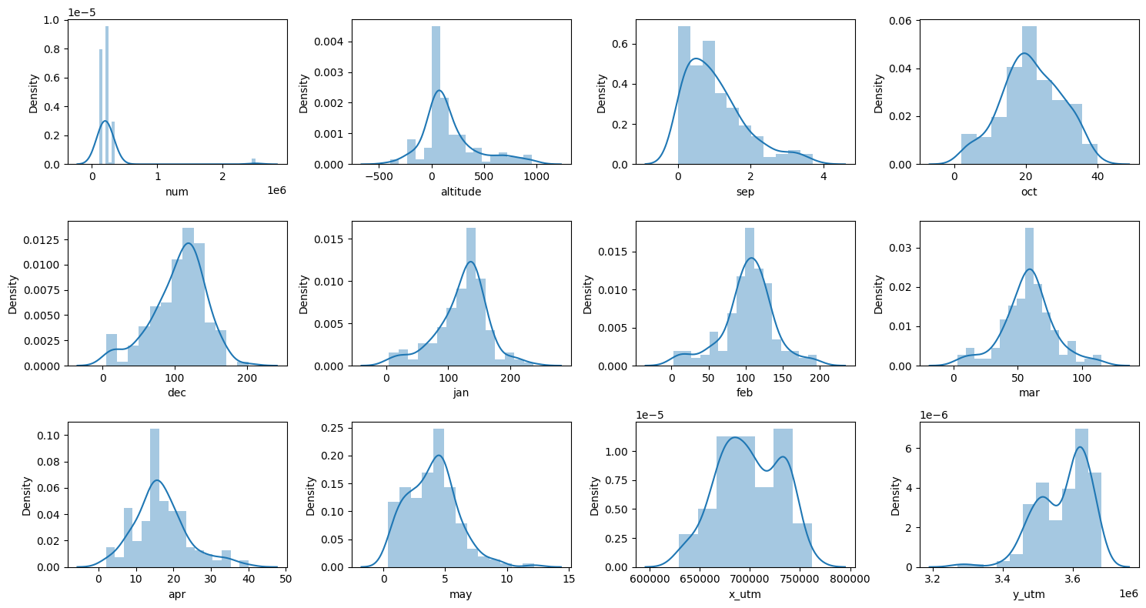
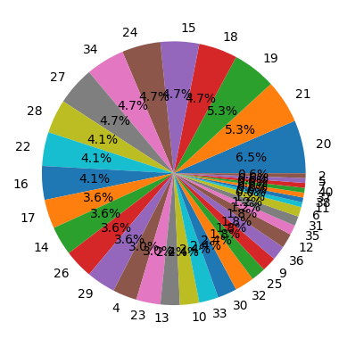
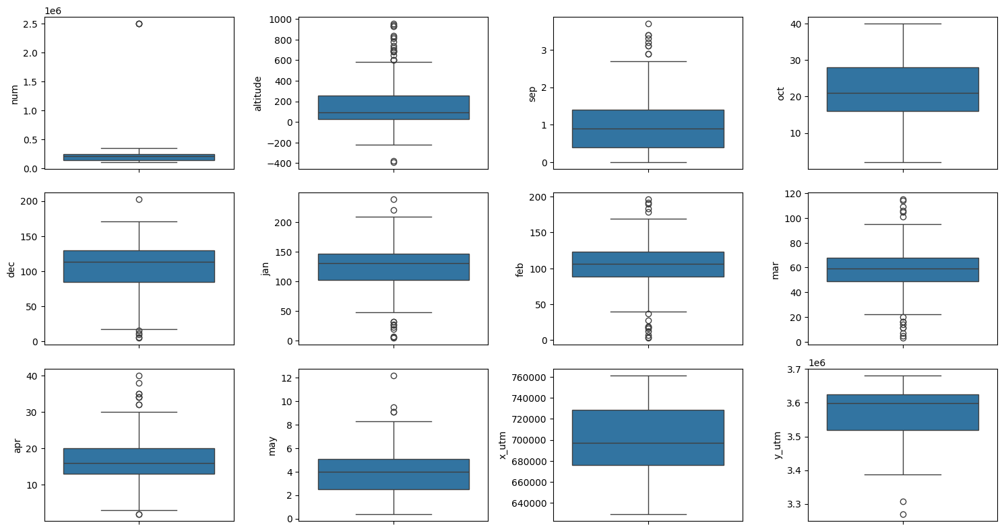
RESULTS
Demo Link:Dharshana2210/TNSDC---Generative--AI (github.com)
3/21/2024 Annual Review
10

